Slide 1
Major Project

Slide 2
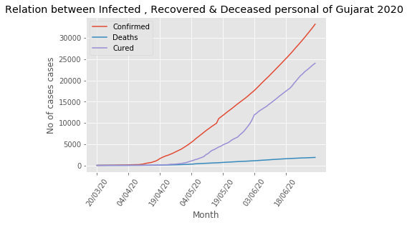
Relation between Infected , Recovered & Deceased personal of Gujarat 2020

Slide 3
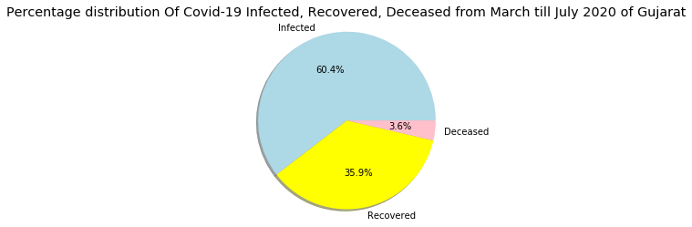
Percentage distribution Of Covid-19 Infected,Recovered, Deceased from March till July 2020 of Gujarat

Slide 4
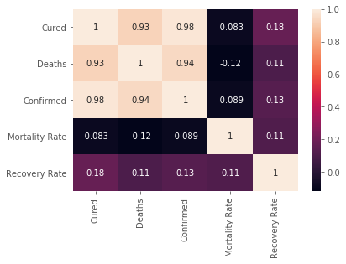
Heat Map

